Slide 1
Molecular Genetics and its Applications in Forensic Sciences

Slide 2
Introduction
Forensic identification is a universal method used to establish the truth in the process of forensic investigation. The evidence includes, among other components, the identification but without being mistaken for it or being reduced to just this.
Both medico‐legal and criminalities identification are integrative parts of forensic identification, having probative value. The value of an identification method resides in the expert's ability to compare traces left at the crime scene with traces found on other materials such as reference evidence. Through this method, one can compare: traces of blood left at the crime scene with those found on a suspects’ clothes and with samples from the victim. Furthermore, the rifling can be compared with fingerprints left on the weapon and with the rifling of other weapons.
Medico‐legal identification is based on intrinsic scientific methods or scientific methods absorbed from other sciences, usually bio‐medical sciences. Scientific progress from the last 30–40 years has highlighted and continues to highlight the role of the specialists in identification. Their role proves its importance in cases that have to do with civil and criminal law, family law, as well as in cases of catastrophes with numerous victims (natural, accidents, wars, terrorist attacks).
Together with the discovery by Mullis in 1983 of the polymerized chain reaction (PCR), Sir Alex Jeffreys will introduce in the field of forensic genetics this technique by studying a set of DNA fragments that proved to have unique characteristics, which were nonrecurring and inherent for each individual, the only exception being monozygotic twins. Alec Jeffreys named these reaction products “genetic fingerprints”.

Slide 3
Short history of forensic genetics
In 1880, British anthropologist Sir Francis Galton published the first studies on digital fingerprinting as an identification method of a certain person.
Another important step in forensic identification was discovering the protein polymorphism of the AB0 blood groups by the Austrian doctor Landsteiner at the beginning of the twentieth century.
After year 1950, in the forensic serology, laboratories were tested a number of blood and tissue antigens, culminating with researching the major histocompatibility complex (HLA).
Sir Alec Jeffreys introduced for the first time the DNA fingerprinting in the field of forensic genetics, proving that some regions from the DNA contain repetitive sequences which are variable among individuals [1]. He was the first to prove the importance of using genetic fingerprinting in the case of forensic personal identification (crimes, filiation, consanguinity, sexual abuse, immigration).
Due to this discovery, the first case of forensic genetics could be solved using the DNA analysis [2]. After murdering of two girls in 1983 and 1986, the police organized the blood sample collection from 5000 men living in the area where the murder took place, and finally found the killer by his DNA profile [3].

Slide 4
Short history of forensic genetics
In 1983, Kary Mullis developed the polymerase chain reaction (PCR) technique which opened new ways in DNA analysis in the forensic genetics. Thus, from each biological human trace or micro‐trace containing nucleated cells, the DNA is extracted to be subjected to amplification reactions. The method is an enzymatic process by which regions of the DNA are replicated (multiplied) 28–34 times, generating about one billion (109 ) copies. This technique highlights the number of repetitions of the base unit and turns them into alpha‐numeric values, known as genetic profiles.
Genetic analysis of a very small number of nucleated cells, namely a very small amount of biological material, is made by a different approach from the usual situations and aims to generate, through the reaction of amplification, the sufficient quantity of copies of DNA fragments to obtain an exploitable genetic profile. This method is applicable to biological samples with a DNA matrix containing <50 pg., to biological micro‐traces, to biological samples that are in an advanced stage of decay, with single source or multiple sources.
For the last two decades, the results of the DNA analysis have been accepted as evidence in the court in many countries [4]. Since February 1992 when The European Council issued the Recommendation No. 92, regarding the use of the DNA analysis in the criminal justice the DNA test is accepted in the Court [5].

Slide 5
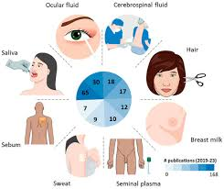
Biological sample collection
Samples
Biological samples consisting of nucleated cells are
essential
for forensic genetic profiling [6].
Biological samples belonging to this category are as follows:
• Liquid blood or dry deposited on supports;
• Liquid semen or dry deposited on supports;
• Various biological secretions (saliva, semen) or mixtures
of secretions originating after
sexual acts;
• Hard tissues (bone, teeth);
• Hairs with follicles (“root”);
• Slides and cytological smears

Slide 6
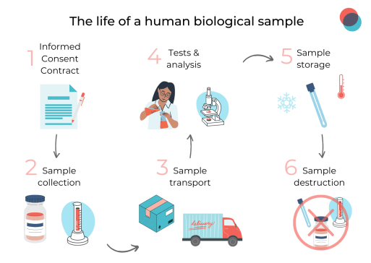
Sample collection, storage, and characterization for DNA analysis
Nowadays, whole blood is considered to be the most widely used source of DNA. It is
harvested on anticoagulant EDTA (ethylenediaminetetraacetic acid). It can be conserved at
4°C for a maximum of 5–7 days; after this time, the DNA sample being kept at -20°C for a few
weeks, or at -80°C for longer periods of time [7].
In the case of blood harvested during autopsy, it does not need anticoagulant and it can be
harvested from the following organs:
• Heart chambers;
• Skeletal muscles or heart muscle;
• Peripheral vessels;
• Long bones;
• Other tissue types.

Slide 7
Sample collection, storage, and characterization for DNA analysis
Apart from whole blood, epithelial cells from oral mucosa as well as hair are considered to be
important sources for DNA analysis, being frequently used. In the case of epithelial cells, they
are harvested with a sterile bud or brush. After harvesting, they are wrapped in a paper
envelope and put to dry. Hair is taken by pulling, 5–10 with the root being enough for the
analysis.
The hair is wrapped in paper envelopes or plastic wrapping and is kept in a dry environment,
at room temperature [8].
In comparison with the biological samples mentioned earlier, in the case of tissue, muscles,
organs, or skin, the harvested volume needs to be between 2 and 4 cm. Right after harvesting,
the DNA extraction and isolation follows because both its quantity and quality decrease in
time and depend on the storage conditions.

Slide 8
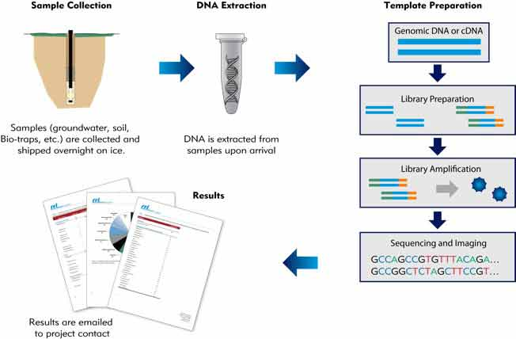
Characterization of the DNA analysis
DNA analysis is a complex process which consists in the following phases:
a. DNA extraction;
b. DNA quantification;
c. DNA amplification;
d. Detection of the DNA amplified products

Slide 9
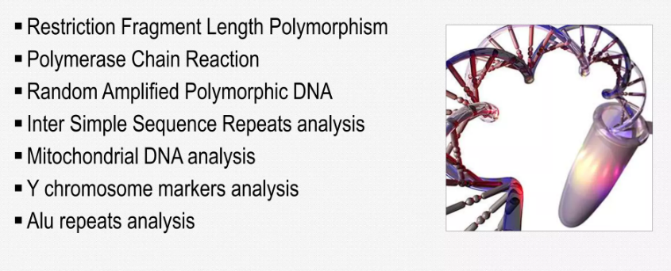
Methods used in forensic for human identification
Autosomal STR profiling
Autosomal single‐nucleotide polymorphisms (SNP) typing

Slide 10
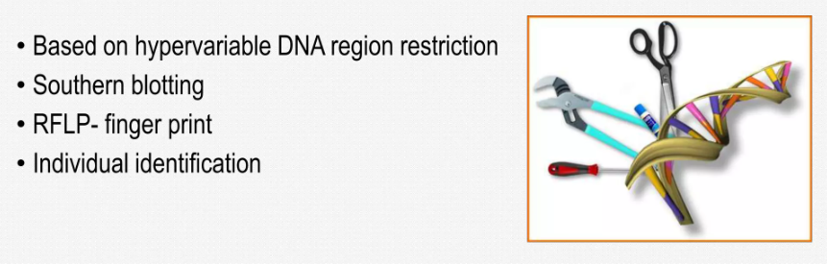
Restriction Fragment Length Polymorphism (RFLP)
Restriction fragment length polymorphism (RFLP) analysis is a method used to indirectly collect information on mutations occurring at specific short regions (restriction sites). RFLP enabled the detection of polymorphisms at the DNA sequence level. RFLP are first class genetic markers, allowing the construction of highly saturated linkage maps. Restriction Fragment Length Polymorphism (RFLP) is a technique in which organisms may be differentiated by analysis of patterns derived from cleavage of their DNA. If two organisms differ in the distance between sites of cleavage of a particular restriction endonuclease, the length of the fragments produced will differ when the DNA is digested with a restriction enzyme. The similarity of the patterns generated can be used to differentiate species (and even strains) from one another.

Slide 11
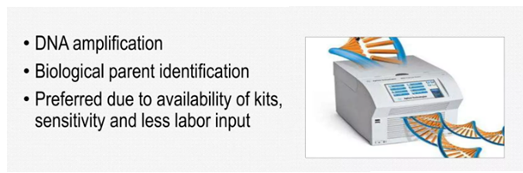
Polymerase chain reaction
Polymerase chain reaction (abbreviated PCR) is a laboratory technique for rapidly producing (amplifying) millions to billions of copies of a specific segment of DNA, which can then be studied in greater detail.
PCR relies on a thermostable DNA polymerase, Taq polymerase, and requires DNA primers designed specifically to select a segment of the genome to be amplified.
In PCR, the reaction is repeatedly cycled through a series of temperature changes, which allow many copies of the target region to be produced.
PCR has many research and practical applications. It is routinely used in DNA cloning, medical diagnostics, and forensic analysis of DNA.

Slide 12
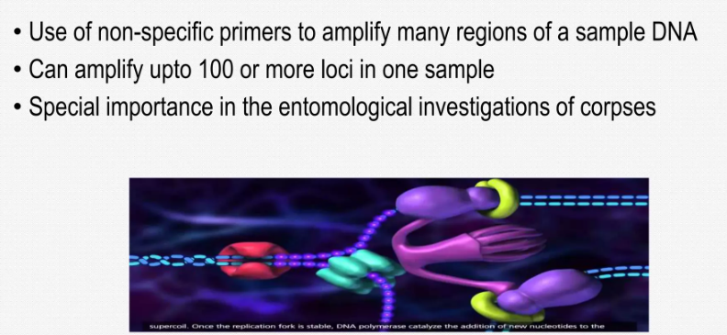
Randomly amplified polymorphic DNA
RAPD is a PCR based technology in which DNA polymorphism assay is based on the amplification of random DNA segments with single primers of the arbitrary nucleotide sequence. A single type of primer is used to anneals to the genomic DNA at two different sites on complementary strands. RAPD polymorphism is detected by using short synthetic oligonucleotides (8-15 bases long) of random sequences as primers in a PCR reaction. In a strain that has DNA sequences in its genomic, complementary to the primer oligonucleotides, PCR products will be detected in the gel by ethidium bromide staining, while in those strains that do not have the complementary sequences, no product will be detected. The application of RAPDs ranges from studies at the individual level, as well as closely related species and gene mapping studies also.
If two template genomic DNA sequences are different, the PCR products display different banding patterns. Polymorphisms detected by these techniques can be used as taxonomic markers in population studies of a wide variety of organisms

Slide 13
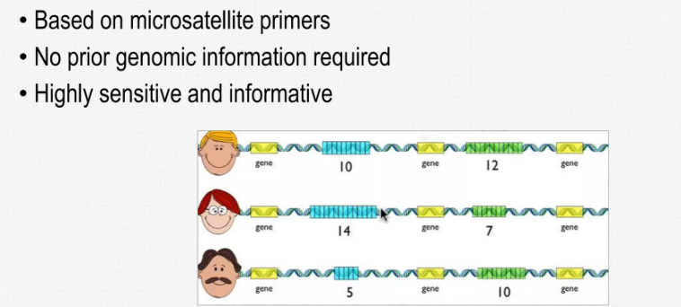
Inter-simple sequence repeat (ISSR) analysis
Inter simple sequence repeats (ISSRs) are DNA segments ranging in size from 100 to 3000 bp that are found between neighboring, oppositely orientated microsatellite sections. ISSRs are amplified using PCR using microsatellite core sequences as primers and a few chosen nucleotides as anchors into nonrepeat neighboring areas (16–18 bp). Approximately 10–60 fragments from various loci are created concurrently, separated by gel electrophoresis, and scored as the presence or absence of fragments of a certain size. ISSR analysis techniques include single primer amplification reaction, which uses a single primer having just a microsatellite's core motif, and directed amplification of minisatellite-region DNA, which utilizes a single primer containing only a minisatellite's core motif (Bornet & Branchard, 2001).

Slide 14
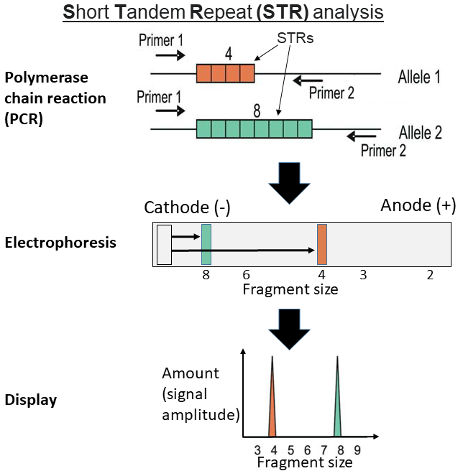
Autosomal STR profiling
In forensic DNA typing, short tandem repeats (STR) or microsatellites are the most frequently genotyped in order to distinguish between individuals, to tie an individual to a crime or to exonerate the innocent. STRs were discovered in the 1980s [9] and since then, they are the “gold standard” in human identification in forensic investigations. They consist of mono‐, di‐, tri‐, tetra‐, penta‐, and hexa‐nucleotide repeat. An individual can be either homozygous (with the same number of repeats) or heterozygous (different number of repeats) in a certainly locus.
Tetra‐nucleotide repeats are used for genotyping in forensic DNA analysis [10]. STR profiles obtained from biological samples found at crime scenes are compared with other profiles of known suspects and are identified by police or are included in a national forensic DNA database [11]. Also, the STR profiling is used in paternity/maternity testing, disastervictim identification (DVI), rape perpetrators identification, and kinship testing [12].
Due to the STR profiles, in numerous cases, the persons have been excluded from involvement in crimes and have been exonerate. A main advantage of the STRs markers consists in the fact that they can test in a rapid, simple, and simultaneously way more than 10 STR loci by multiplexing [13]. Due to this characteristic, it offers an increased degree in the identification of different biological samples.

Slide 15
Autosomal STR profiling
The tetra‐nucleotide and penta‐nucleotide systems are included in the multiplex analysis kits because they can provide results with an increased index of exclusion. The nomenclature of the STR loci and the allelic variants was established in 1993 by the DNA Commission of the International Society of Forensic Genetics (ISFG). Except their usefulness in forensic DNA analysis, STRs became used in medical genetic research, because it has been demonstrated that the trinucleotide STR loci is associated with some genetic disorders. The DNA profile refers to the genotype (the number of repeats found in each allele of the analyzed STR marker) of a suspect, victim, or crime scene sample.
In the development of STR typing system, in 1997, the Federal Bureau of Investigations (FBI) introduced the database named CODIS (Combined DNA Index System) that included 13 autosomal loci and the amelogenin sex test [14]. These loci are highly polymorphic, localized in non‐coding regions which are on different chromosomes. As an improvement in their efficiency, the new multiplexes that amplify 16 loci or more, in a single reaction (including amelogenin too), have been introduced in the last years [15]. The most common STR kits used in the forensic laboratories for the identification are manufactured by three companies: Life Technologies, Promega and Qiagen.
The forensic DNA analysis is made through multiplex PCR amplification of 10–16 STRs or more, followed by automated sequencing equipment, such as capillary electrophoresis (CE) [16].
The STR‐based forensic DNA analysis has been well accepted by population and professionals, as an important tool in human identifications and in the criminal justice.
Other sources of genetic variations that have been demonstrated to present more specialized uses in forensic identification are as follows: autosomal SNPs, the markers on the Y chromo‐ some and mitochondrial DNA (mtDNA).

Slide 16
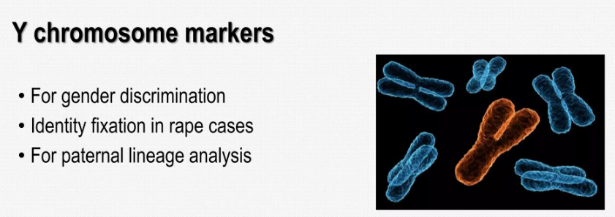
Analysis of the Y‐chromosome
In forensic medicine, the Y‐chromosome has only one useful property: It is present only in males. Thus, in crime cases, the investigators expect to find Y‐chromosome at the scene. Also, when talking about male–female ratio in body fluid mixtures, such as rapes, by analyzing the Y‐STR component, the investigators can obtain more information regarding the male compo‐ nent. It is well known that vasectomized or azoospermic rapists do not leave sperm traces, and it is impossible to find spermatozoa on the microscopic examination. In such cases, the Y‐STR profiling is very useful, offering information regarding the identity of the rapist [17].

Slide 17
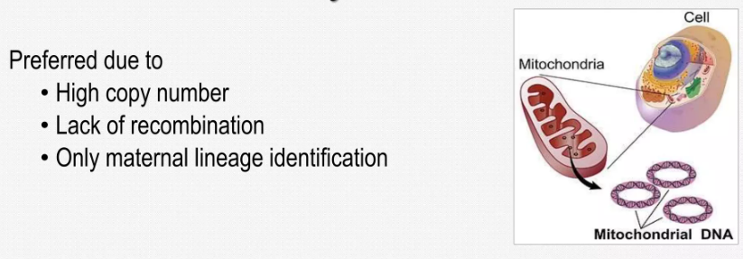
Analysis of mitochondrial DNA (mtDNA)
Mitochondrial DNA (mtDNA) is inherited on the maternal line; thus, all the members of a matrilineal share the same haplotype. Its advantage relies on the fact that it has a number of 200–1700 copies per cell and has an increased probability of survival compared to the nuclear DNA. Therefore, the forensic applications for mtDNA include analysis of biological samples that are old or severely degraded, and analysis of biological samples which contain a low amount of DNA (e.g., hair shafts). MtDNA has been used to identify the Tsar Nicholas II and his brother Georgij Romanov [18].

Slide 18
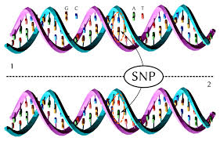
Autosomal single‐nucleotide polymorphisms (SNP) typing
Single‐nucleotide polymorphisms (SNPs) have a lower heterozygosis when compared to STRs. The advantage of SNP typing consists in the fact that the DNA template size can be as large as 50 bp, compared to the STRs which need the DNA template size of 300 bp, to obtain a good STR profiling [19]. Due to this, the SNPs became important tools in analyzing degraded samples. Thus in 2001, SNP typing was used in identifying the victims from the World Trade Center disaster [20, 21]. Related to the use of SNP analysis in degraded biological samples, the European Network of Forensic Science Institutes (ENFSI) and the US FBI Scientific Working Group on DNA Methods (SWGDAM) are working on recommendations regarding the standardization of the SNPs [22].

Slide 19

Impact of genetic identification on justice
At the present time. genetic testing using DNA has wide applicability to the field
of justice, this method being used for the following:
• Identification of suspects and confirmation of guilt;
• Exculpation of innocent parties;
• Discovering of persons who commit crimes, or serial killers;
• Researching biological filiation;
• Establishing consanguinity in more complex cases;
• Establishing biological bloodline relations that serve in finding the historical truth (the
Romanov case, the case of Louis XVII of France, the Nazi doctor Joseph Mengele)
• Identification of victims of terrorist attacks or natural catastrophes;
• Identification of certain probes for medical testing (tissue for histology testing, blood alcohol
content testing, other toxicological tests).

Slide 20
Emerging biomarkers in forensic identification
Forensic genetics will continue to develop and improve its methods, due to the advances in the technical development. The key element in forensic protocols is to identify the origin of biological traces found at the scene. In the last 5 years, some studies have demonstrated that messenger RNA (mRNA) can be useful in forensic identification. Zubakov et al. [23] have identified some mRNA stable in body fluids, such as blood and saliva.
In recent years, the European DNA Profiling Group (EDNAP) has performed some studies on the RNA/DNA co‐extraction and proved once again the usefulness of mRNA as a tool for the identification of semen and saliva in forensic cases, compared to the DNA methodology [24].
Another important application of mRNA is in the forensic identification of the skin, using the RT‐PCR methods [25].
Since 2009 Hanson et al. [26] have been explored miRNA for their use in forensically body fluids identification. The advantage of these new markers over the mRNAs markers consists in the fact that they have a smaller size containing around 18–22 bp, thus being more stable than mRNA to degradation conditions.
Since last decade new steps have been done in “forensic molecular pathology” and in “post‐ mortem pharmacogenetics”. Studies regarding the molecular diagnosis of genetic cardiac arrhythmia or long QT (a condition affecting relaxing of the heart after a heartbeat, giving rise to an abnormally lengthy QT interval.) syndrome which leads to sudden death [27] and the post‐mortem analysis of gene CYP2D6, which encodes a drug metabolizing enzyme whose variation leads to adverse drug effects and finally to death [28] are new tools which evolve in forensics.

Slide 21
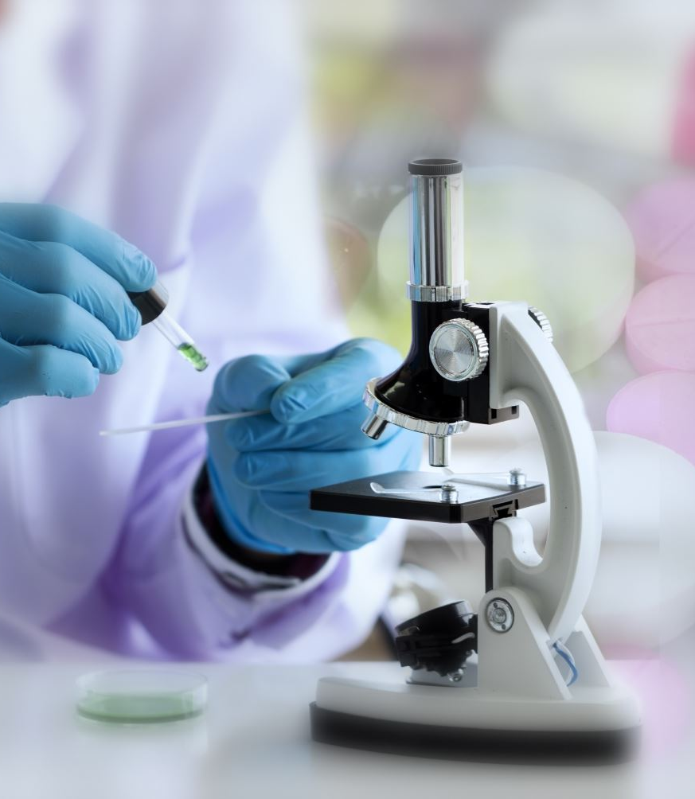
Currently, the DNA genotyping of all types of biological traces or micro‐traces containing nucleated cells is possible if they are not entirely destroyed, either chemically or bacterial. The DNA analysis represents an important tool in solving caseworks in forensic medicine, such as establishing the custody of a child through paternity or maternity tests, identifying victims from disasters or crimes, exonerating innocent people convicted to prison.
Due to the recent advances in molecular genetics, other biomarkers have been proposed to be used in forensic body fluids identifications, such as messenger RNA (mRNA), microRNA (miRNA), and DNA methylation

